Slide 1
Cryptography (2021 Fall) HMAC, birthday attack, Feistel network
LiangFeng Zhang
zhanglf@shanghaitech.edu.cn
SIST, ShanghaiTech

Slide 2




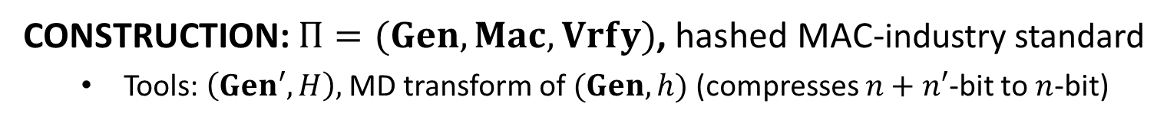












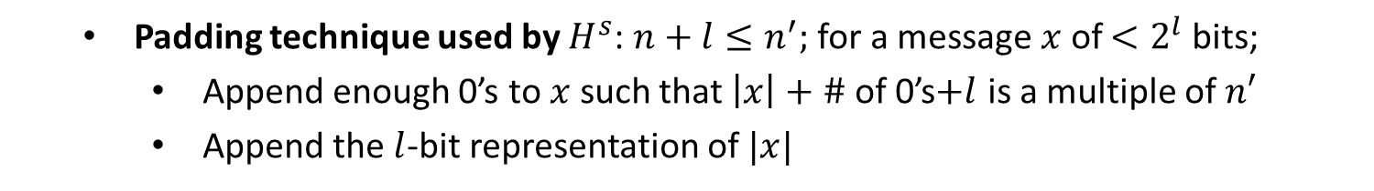






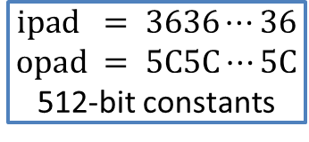
HMAC
CONSTRUCTION: $Π=(Gen, Mac, Vrfy)$, hashed MAC-industry standard
Tools: $\left(Gen′, H\right),$ MD transform of $(Gen, h)$ (compresses $n+n′$-bit to $n$-bit)
$$k⊕ipad$$
$$x_{1}$$
$$⋯$$
$$x_{d}$$
$${y=H}^{s}((k⊕ipad)||m)$$
$$IV$$
$$h^{s}$$
$$h^{s}$$
$$⋯$$
$$h^{s}$$
$$k_{in}$$
$$y^{′}=y||0⋯0||⋯$$
$$ipad = 3636⋯36$$
$$opad = 5C5C⋯5C$$
512-bit constants
$$k⊕opad$$
$$h^{s}$$
$$h^{s}$$
$$t$$
$$IV$$
$$k_{out}$$
$$h^{s}(IV||k⊕opad)$$
Padding technique used by $H^{s}$: $n+l≤n^{′};$ for a message $x$ of $<2^{l}$ bits;
Append enough 0’s to $x$ such that $\left|x\right|+\#$ of 0’s$+l$ is a multiple of $n′$
Append the $l$-bit representation of $|x|$
$$x$$
$$0⋯0$$
$$|x|$$

Slide 3
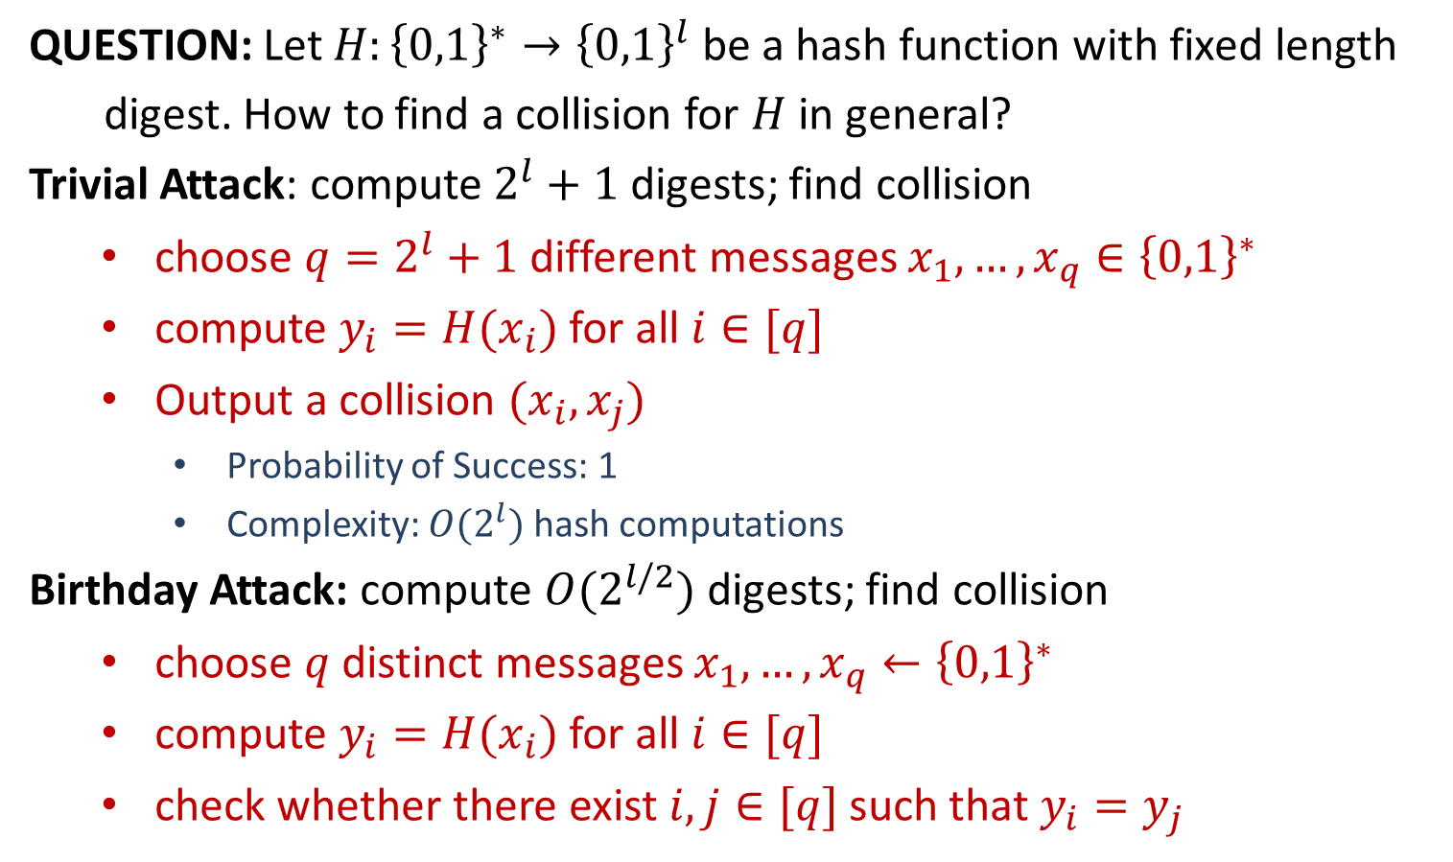
Attacks of Hash Functions
QUESTION: Let $H:{\left\{0,1\right\}}^{∗}→{\left\{0,1\right\}}^{l}$ be a hash function with fixed length
digest. How to find a collision for $H$ in general?
Trivial Attack: compute $2^{l}+1$ digests; find collision
choose $q=2^{l}+1$ different messages $x_{1},…,x_{q}∈{\left\{0,1\right\}}^{∗}$
compute $y_{i}=H(x_{i})$ for all $i∈[q]$
Output a collision $(x_{i},x_{j})$
Probability of Success: 1
Complexity: $O(2^{l})$ hash computations
Birthday Attack: compute $O(2^{l/2})$ digests; find collision
choose $q$ distinct messages $x_{1},…,x_{q}←{\left\{0,1\right\}}^{∗}$
compute $y_{i}=H(x_{i})$ for all $i∈[q]$
check whether there exist $i,j∈[q]$ such that $y_{i}=y_{j}$

Slide 4
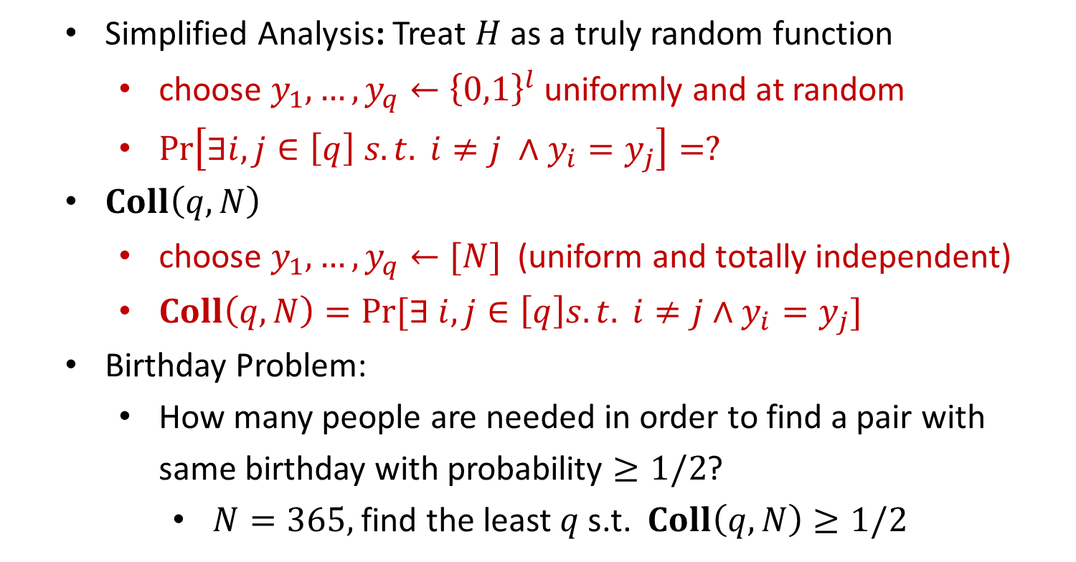
Attacks of Hash Functions
Simplified Analysis: Treat $H$ as a truly random function
choose $y_{1},…,y_{q}←{\left\{0,1\right\}}^{l}$ uniformly and at random
$\operatorname{Pr}\left[∃i,j∈\left[q\right] s.t. i≠j ∧y_{i}=y_{j}\right]=?$
$Coll\left(q,N\right)$
choose $y_{1},…,y_{q}←[N]$ (uniform and totally independent)
$Coll\left(q,N\right)=Pr⁡[∃ i,j∈\left[q\right]s.t. i≠j∧y_{i}=y_{j}]$
Birthday Problem:
How many people are needed in order to find a pair with same birthday with probability $≥1/2$?
$N=365,$find the least $q$ s.t. $Coll\left(q,N\right)≥1/2$

Slide 5
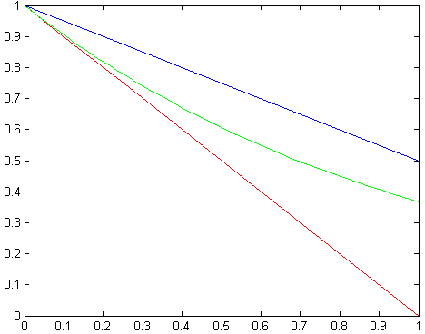
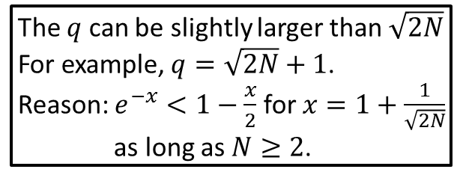
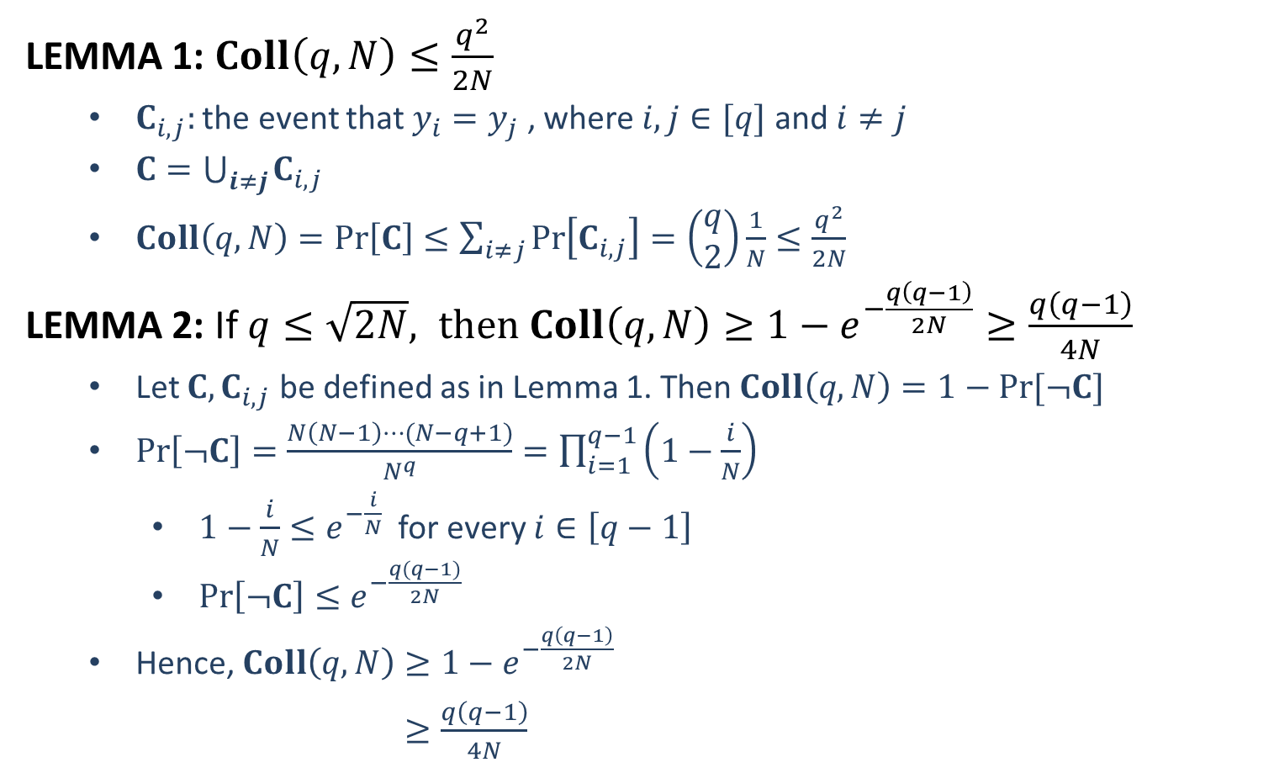



Attacks of Hash Functions
LEMMA 1: $Coll\left(q,N\right)≤\frac{q^{2}}{2N}$
$C_{i,j}:$ the event that $y_{i}=y_{j}$ , where $i,j∈[q]$ and $i≠j$
$C=\bigcup_{i≠j}{C_{i,j}}$
$Coll\left(q,N\right)=\operatorname{Pr}\left[C\right]≤\sum_{i≠j}{\operatorname{Pr}\left[C_{i,j}\right]}=\left(\begin{aligned}q \\ 2\end{aligned}\right)\frac{1}{N}≤\frac{q^{2}}{2N}$
LEMMA 2: If $q≤\sqrt{2N}, then Coll\left(q,N\right)≥1−e^{−\frac{q\left(q−1\right)}{2N}}≥\frac{q\left(q−1\right)}{4N}$
Let $C, C_{i,j}$ be defined as in Lemma 1. Then $Coll\left(q,N\right)=1−Pr⁡[¬C]$
$\operatorname{Pr}\left[¬C\right]=\frac{N\left(N−1\right)⋯(N−q+1)}{N^{q}}=\prod_{i=1}^{q−1}{\left(1−\frac{i}{N}\right)}$
$1−\frac{i}{N}≤e^{−\frac{i}{N}}$ for every $i∈\left[q−1\right]$
$\operatorname{Pr}\left[¬C\right]≤e^{−\frac{q(q−1)}{2N}}$
Hence, $Coll\left(q,N\right)≥1−e^{−\frac{q\left(q−1\right)}{2N}}$
$≥\frac{q\left(q−1\right)}{4N}$
The $q$ can be slightly larger than $\sqrt{2N}$
For example, $q=\sqrt{2N}+1$.
Reason: $e^{−x}<1−\frac{x}{2}$ for $x=1+\frac{1}{\sqrt{2N}}$
as long as $N≥2$.
$$1−\frac{x}{2}$$
$$e^{−x}$$
$$1−x$$

Slide 6
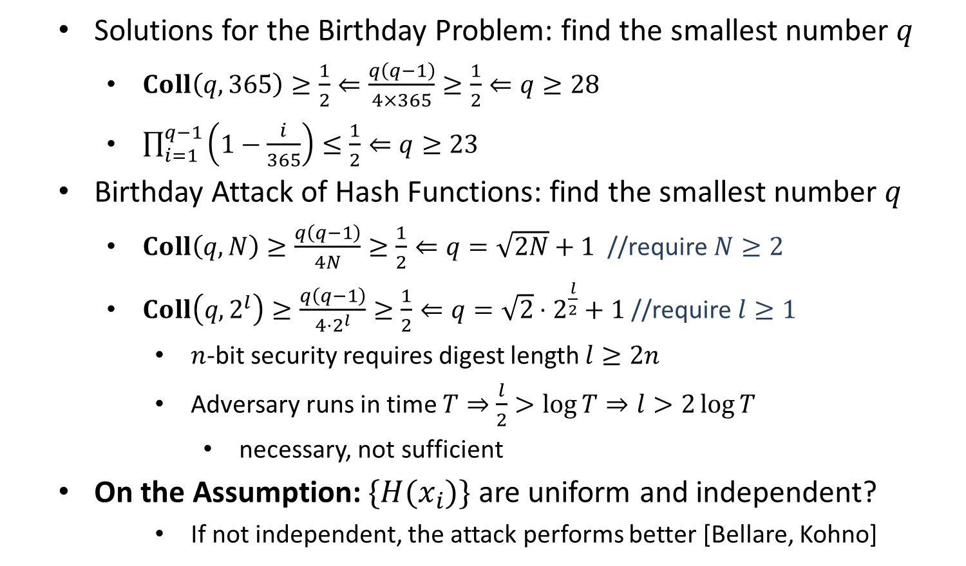
Attacks of Hash Functions
Solutions for the Birthday Problem: find the smallest number $q$
$Coll\left(q,365\right)≥\frac{1}{2}⇐\frac{q\left(q−1\right)}{4×365}≥\frac{1}{2}⇐q≥28$
$\prod_{i=1}^{q−1}{\left(1−\frac{i}{365}\right)}≤\frac{1}{2}⇐q≥23$
Birthday Attack of Hash Functions: find the smallest number $q$
$Coll\left(q,N\right)≥\frac{q\left(q−1\right)}{4N}≥\frac{1}{2}⇐q=\sqrt{2N}+1$ //require $N≥2$
$Coll\left(q,2^{l}\right)≥\frac{q\left(q−1\right)}{4⋅2^{l}}≥\frac{1}{2}⇐q=\sqrt{2}⋅2^{\frac{l}{2}}+1$ //require $l≥1$
$n$-bit security requires digest length $l≥2n$
Adversary runs in time $T⇒$ $\frac{l}{2}>\log{T}⇒l>2\log{T}$
necessary, not sufficient
On the Assumption: $\{H(x_{i})\}$ are uniform and independent?
If not independent, the attack performs better [Bellare, Kohno]

Slide 8
Practical Constructions
Stream Ciphers:
LFSR (linear feedback shift register);
NFSR (nonlinear feedback shift register);
Combination Generator
Trivium, RC4
Block Ciphers: Shannon’s Confusion-Diffusion Paradigm
Feistel Network
DES (Data Encryption Standard)
Substitution-Permutation Network
AES (Advanced Encryption Standard)
Hash Functions:
Davies–Meyer Construction
MD5 (Message Digest 5)
SHA (Secure Hash Algorithm)

Slide 9
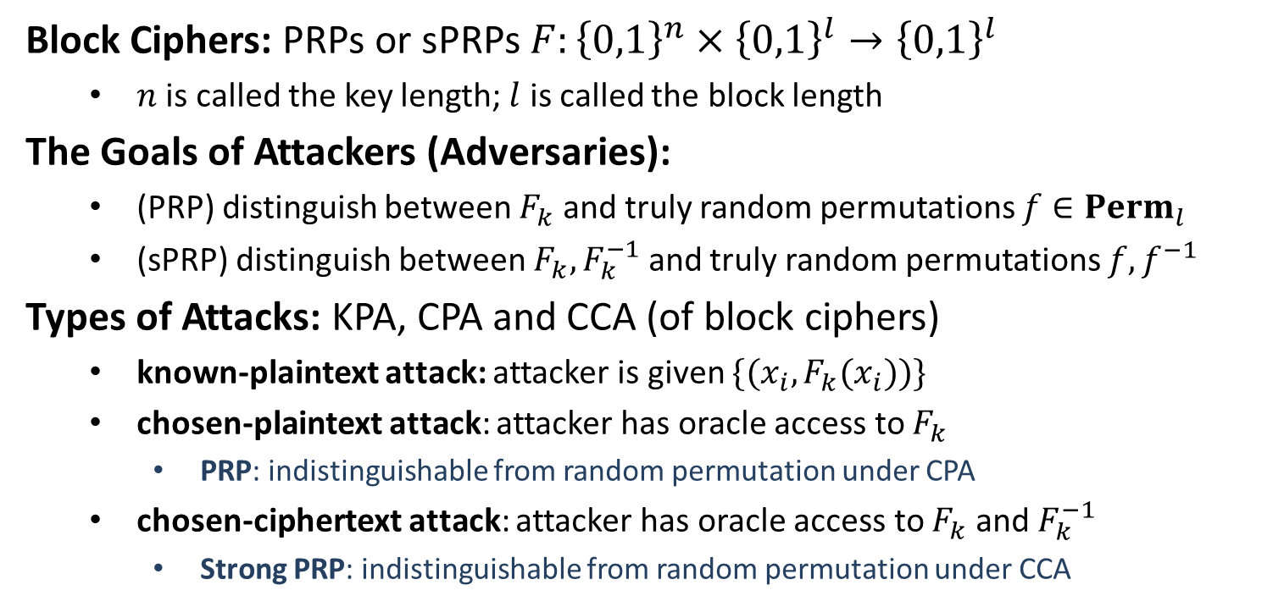
Block Ciphers
Block Ciphers: PRPs or sPRPs $F:{\left\{0,1\right\}}^{n}×{\left\{0,1\right\}}^{l}→{\left\{0,1\right\}}^{l}$
$n$ is called the key length; $l$ is called the block length
The Goals of Attackers (Adversaries):
(PRP) distinguish between $F_{k}$ and truly random permutations $f∈Perm_{l}$
(sPRP) distinguish between $F_{k}, F_{k}^{−1}$ and truly random permutations $f,f^{−1}$
Types of Attacks: KPA, CPA and CCA (of block ciphers)
known-plaintext attack: attacker is given $\{(x_{i}, F_{k}(x_{i}))\}$
chosen-plaintext attack: attacker has oracle access to $F_{k}$
PRP: indistinguishable from random permutation under CPA
chosen-ciphertext attack: attacker has oracle access to $F_{k}$ and $F_{k}^{−1}$
Strong PRP: indistinguishable from random permutation under CCA

Slide 10


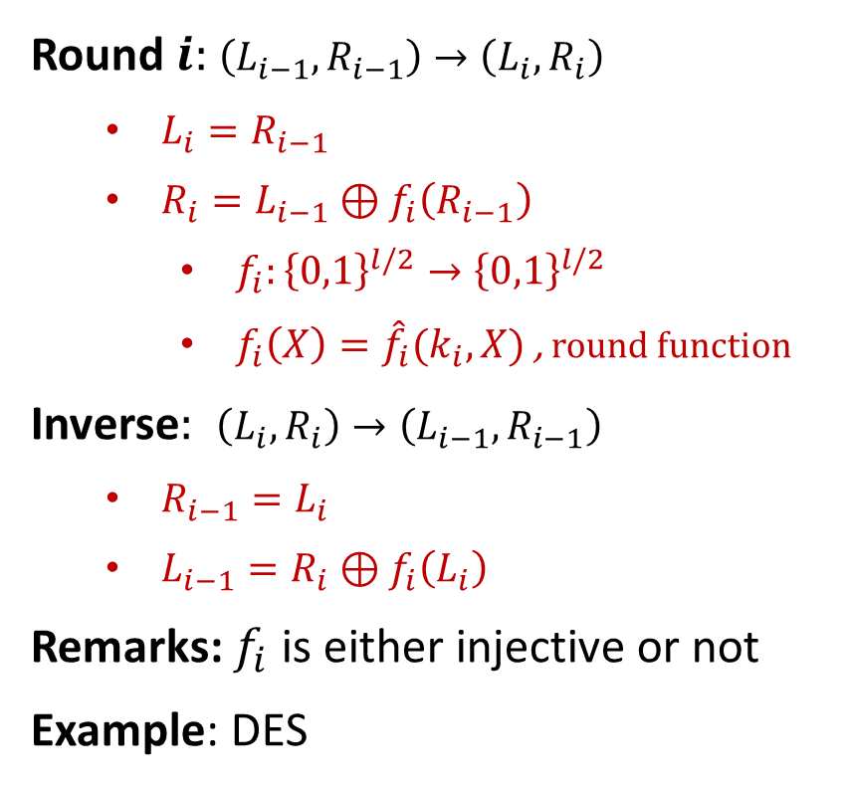









Feistel Network
$$L_{0}$$
$$R_{0}$$
Round $i:$ $\left(L_{i−1},R_{i−1}\right)→\left(L_{i},R_{i}\right)$
$L_{i}=R_{i−1}$
$R_{i}=L_{i−1}⊕f_{i}\left(R_{i−1}\right)$
$f_{i}:{\left\{0,1\right\}}^{l/2}→{\left\{0,1\right\}}^{l/2}$
$f_{i}\left(X\right)={\hat{f}}_{i}(k_{i},X)$ , round function
Inverse$:$ $\left(L_{i},R_{i}\right)→\left(L_{i−1},R_{i−1}\right)$
$R_{i−1}=L_{i}$
$L_{i−1}=R_{i}⊕f_{i}\left(L_{i}\right)$
Remarks: $f_{i}$ is either injective or not
Example: DES
$$f_{1}$$
$$L_{1}$$
$$R_{1}$$
$$f_{2}$$
$$L_{2}$$
$$R_{2}$$
$$f_{3}$$
$$L_{3}$$
$$R_{3}$$

